Slide 1
Cloud Microservices Programing Introduction
Mostafa Rastgar
May 2019

Slide 2
Workshops Agenda
Microservices introduction
Spring boot and rest webservices
Design patterns for microservices
Config Servers
Service Registry
Client side & Centralized load balancing
Circuit breaker
Kafka and Redis Introduction
Spring cloud streaming
Service call tracing
Security

Slide 3
Today is Microservices introduction
What are microservices?
What is domain driven design?
Microservices based application architecture
Run the sample demo
Our workshops sample project

Slide 4
What are microservices?
Breaking the application into smaller pieces which compose together
Each component is continuously developed and separately maintained
The application is then simply the sum of its constituent components
In contrast to a traditional, "monolithic" application which is all developed all in one piece
There are other benefits:
Developer independence: Small teams work in parallel and can iterate faster than large teams.
Isolation and resilience: If a component dies, you spin up another while and the rest of the application continues to function.
Scalability: Smaller components take up fewer resources and can be scaled to meet increasing demand of that component only.
Lifecycle automation: Individual components are easier to fit into continuous delivery pipelines and complex deployment scenarios not possible with monoliths.
Relationship to the business: Microservice architectures are split along business domain boundaries, increasing independence and understanding across the organization.

Slide 5

How to break the application into smaller pieces
Domain Driven Design can be a good starting point

Slide 6
What is domain driven design
A formal definition:
When we are developing a software our focus shouldn’t be primarily on technology, it should be primarily on business or whatever activity we are trying to assist with the software, the domain.
Specifically we approach that by trying to develop models of that domain and make our software conformed to that.
Domain driven design is a way of looking at software from top down

Slide 7
What is top down?
Tactical Design Tools
Service
Strategic Design Tools
Project
Layers
Domain
Modules
Design Patterns
Sub-Domain
Sub-Domain
Sub-Domain
OOP
Service
Service
Service
Classes
Objects
Exe / Jar / Zip

Slide 8
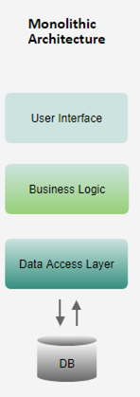
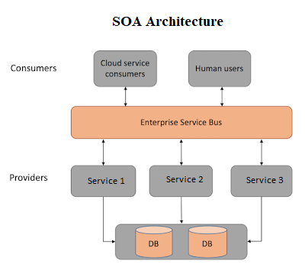
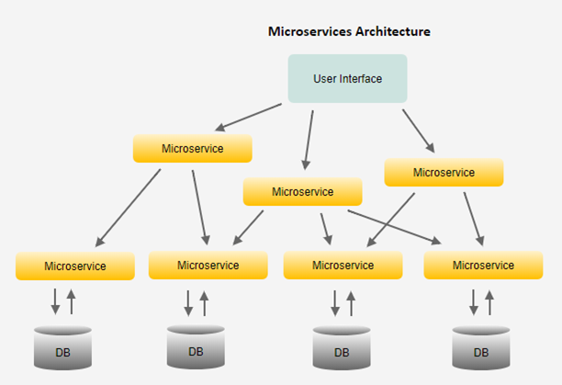
What will our application be like when we break into microservices?

Slide 9
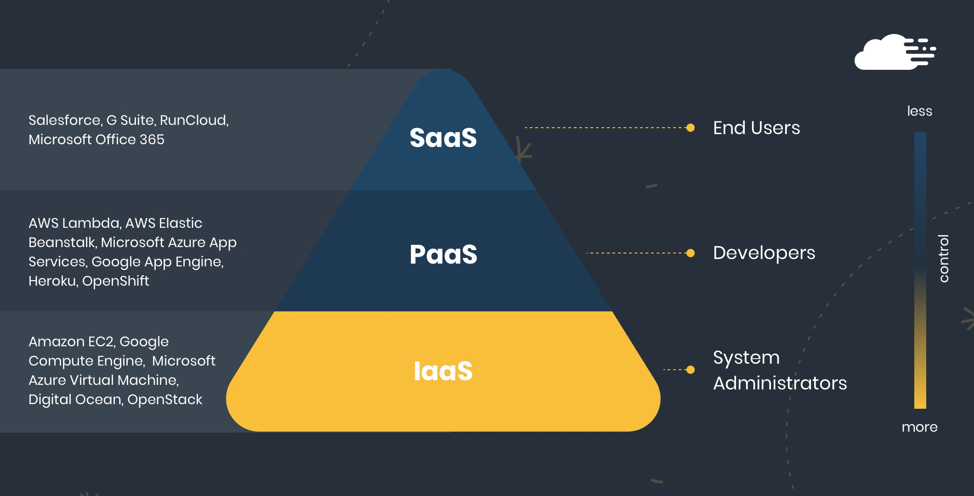
Cloud Pyramid

Slide 10
Run sample demo
Replication
Forex Service
Currency Conversion
currency-converter-feign/from/USD/to/SEK/quantity/1000
Forex Service
Eureka Service Registry

Slide 11
Our workshops sample project
Payment Project
Receive Payment Order
Validation
Final Process
Syntax
Receive a new Payment Order
Send to beneficiary
Semantic
Withdraw the available balance
Insert ledger
Receive a Negative Status
Validation
Final Process
Syntax
Receive a negative status
Cancel the original payment
Semantic
Deposit the available balance
Send the final status to the both beneficiary and originator

Slide 12


